Slide 1

Multivariate Transfer Function
Using a Multivariate Transfer Function to Forecast the VGSLX
Serge Alhalbi
Supervisor: Dr. Maher Qumsiyeh
MTH 541: Mathematics Clinic
Term: Spring 2023

Slide 2
Outline
INTRODUCTION
Objective
Data Visualization
Flow Chart
ANALYSIS
Preprocessing Data
Autoregressive and Moving Average Models
Transfer Function
Diagnostics and Final Model
RESULTS
CONCLUSION

Slide 3
Introduction
What are mathematical models?
Mathematical models are abstract representations of real-world systems or phenomena.
Deterministic | Stochastic
Linear | Nonlinear
Static | Dynamic
Discrete | Continuous
Empirical | Theoretical
Parametric | Nonparametric

Slide 4
Objective
What is a time series?
A time series is a sequence of data points measured over time, typically at regular intervals.
Time series analysis and forecasting
captures the temporal dependencies present in the data that are left undescribed.
can be applied even when only one time-based variable is known.
helps in forecasting future market trends and making informed investment decisions.
t | y
1 | 216
2 | 279
⋮ | ⋮
2000 | 223

Slide 5
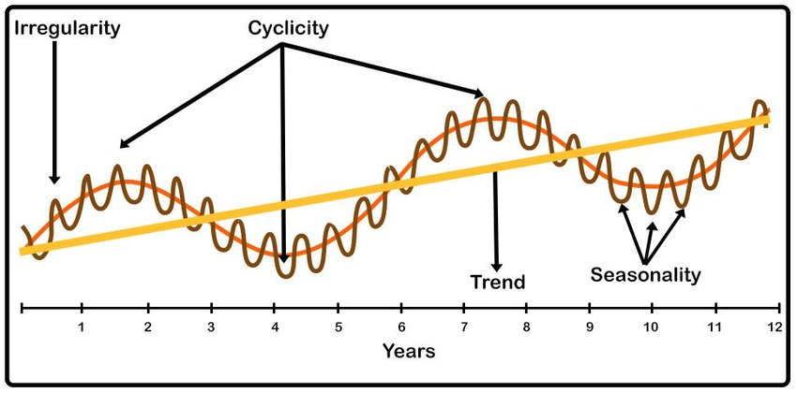
Objective
What are time series components?

Slide 6
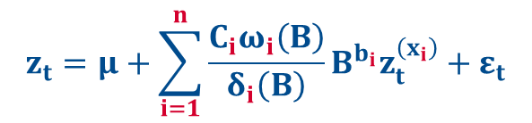

Objective
Multivariate transfer function
$$z_{t}=μ+\frac{Cω\left(B\right)}{δ\left(B\right)}B^{b}z_{t}^{\left(x\right)}+ε_{t}$$
$$z_{t}=μ+\sum_{i=1}^{n}{\frac{C_{i}ω_{i}\left(B\right)}{δ_{i}\left(B\right)}B^{b_{i}}z_{t}^{\left(x_{i}\right)}}+ε_{t}$$

Slide 7
Data Visualization
Variables
S&P 500 and MCD are highly correlated with VGSLX.
Vanguard Real Estate Index Fund (VGSLX)
y
S&P 500 (^GSPC)
x₁
McDonald’s (MCD)
x₂

Slide 8

Data Visualization
Data description
505 values measured from the start of 2020 to the end of 2021.
Adjusted closing price per share values.
Daily, excluding weekends and certain holidays.
COVID-19 had a significant impact on stock prices in February 2020.

Slide 9
Data Visualization

Slide 10

Flow Chart
Forecasting
Diagnostics
Modeling
Preprocessing

Slide 11
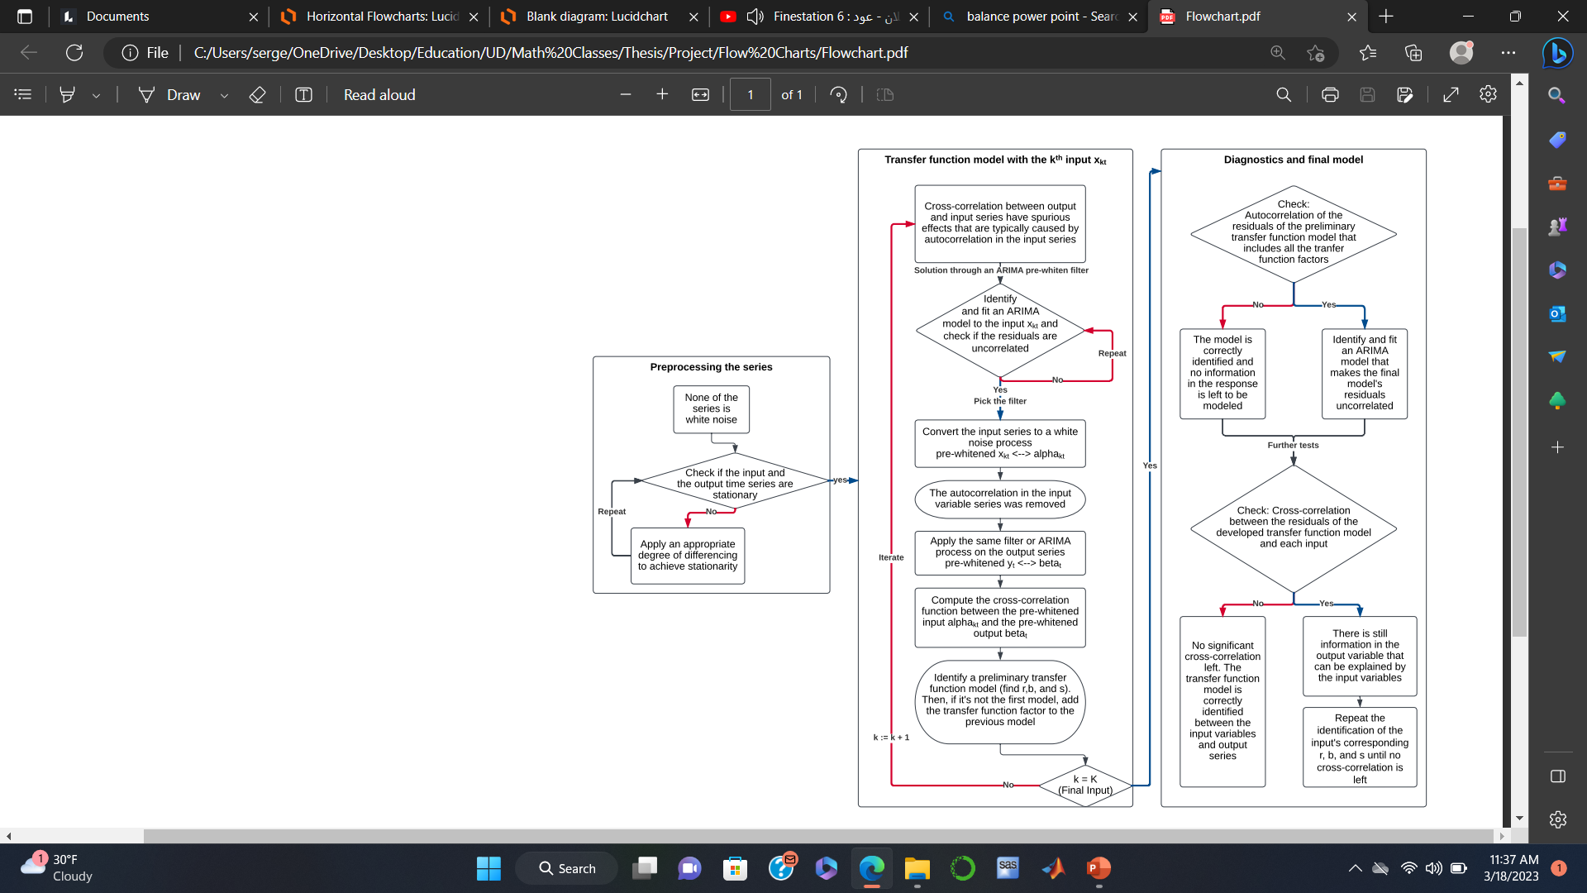
Detailed Flow Chart
(Used for questions)

Slide 12
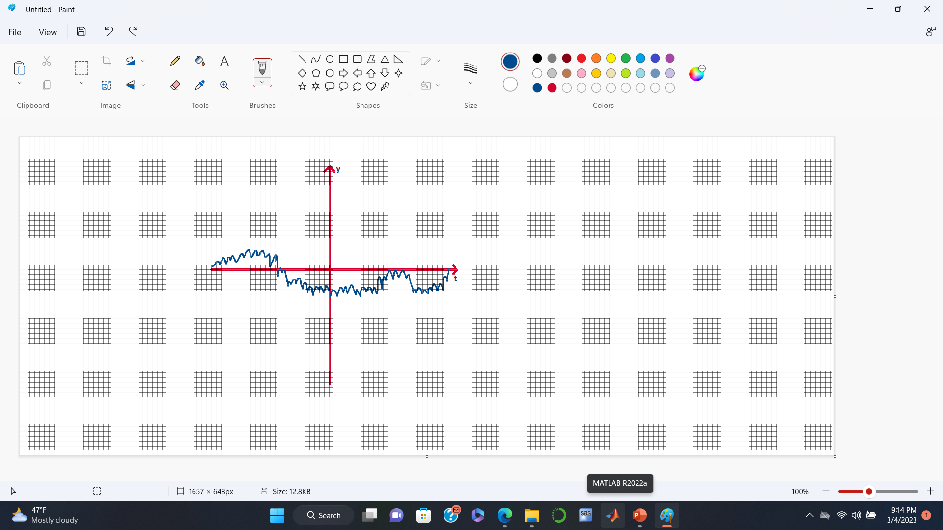
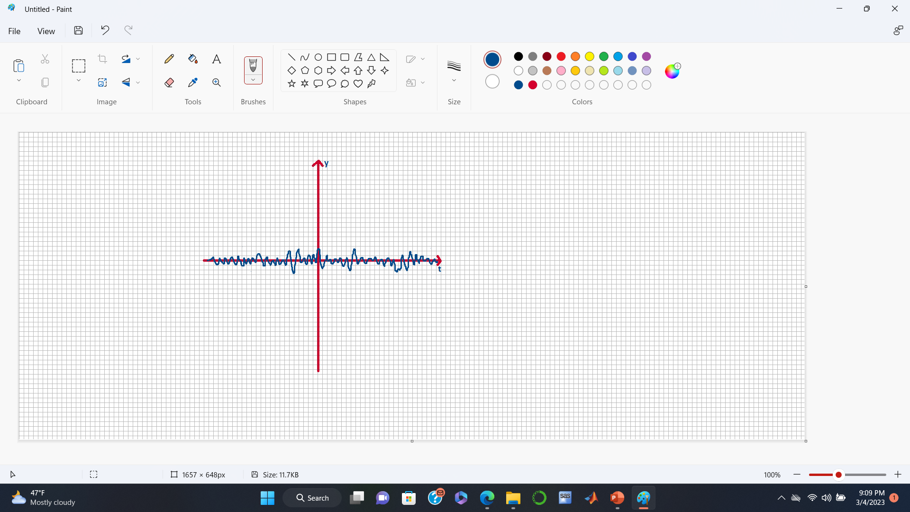
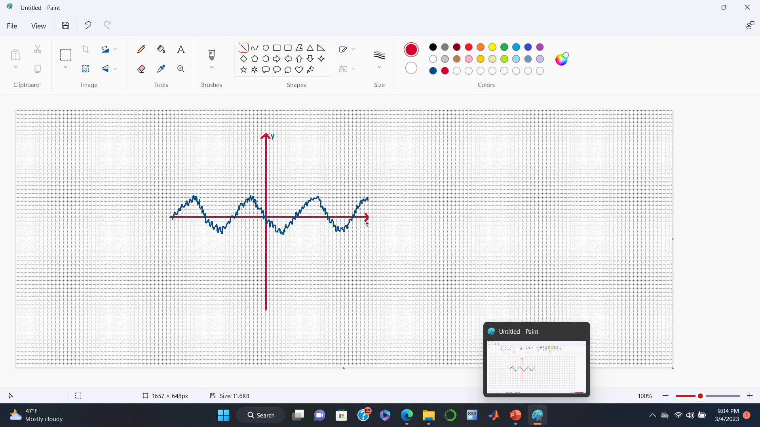
Preprocessing: White Noise
What is a white noise series?
A type of time series that can’t be modeled, meeting the following criteria:
Zero mean
Violated
Constant variance
Violated
No correlation between lags
Violated
1
2
3

Slide 13
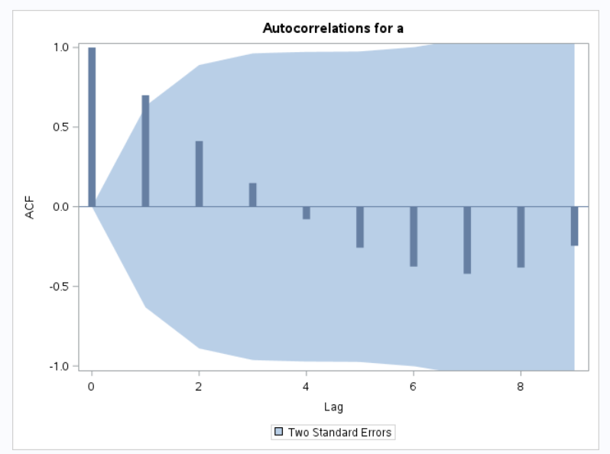
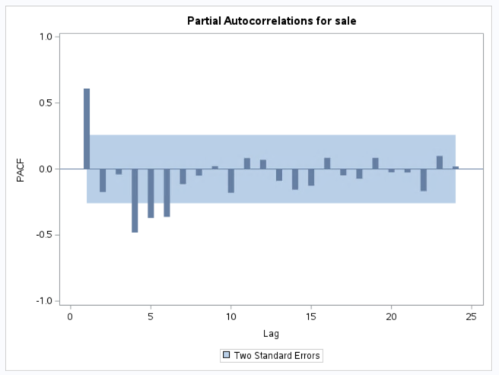
Preprocessing: White Noise
Three ways to test if a series is white noise: Visually, Ljung-Box test, and Plots.
Correlation
y_{t} = α + β₁y_{t-1} + β₂y_{t-2}
ACF: Autocorrelation function
PACF: Partial autocorrelation function

Slide 14
Preprocessing: White Noise
Explaining the variable y
Finding a process that makes the noise/residuals y_{t} – Signal white noise
Time series assumption
y_{t} = Signal + Noise

Slide 15
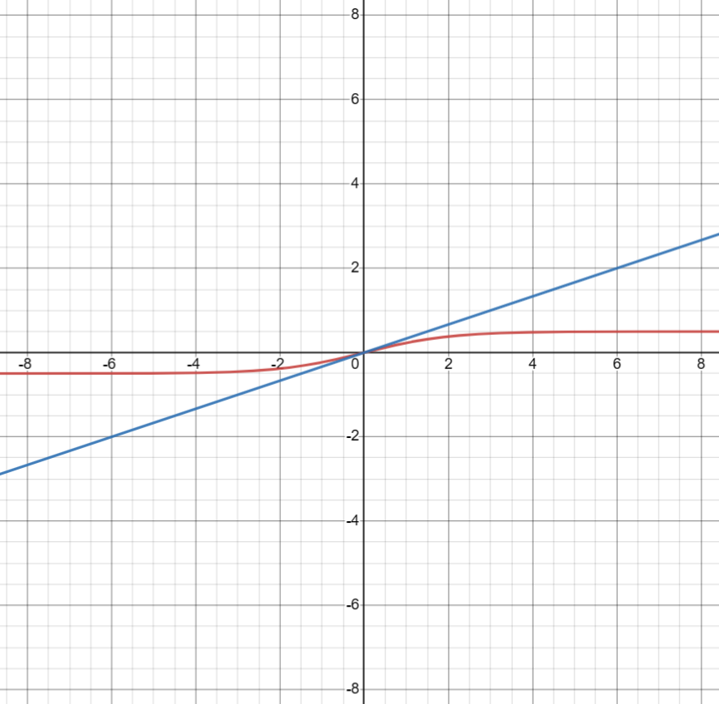
Preprocessing: White Noise
Time series assumption
y_{t} = Signal + Noise
y
Signal
Counter example
y_{t}
(Residuals are not white noise)
t
ε_{t}
Bad modeling

Slide 16
Preprocessing: Stationarity
What is a stationary series?
A time series that has consistent statistical characteristics, including an unchanging mean and variance, throughout time.
Why does it matter?
Intuitively, the parameters will not be time dependent.
How do we test if a series is stationary? | How do we make a time series stationary?
Visually | Differencing
ACF and PACF plots | Other transformations
Statistical hypothesis testing

Slide 17
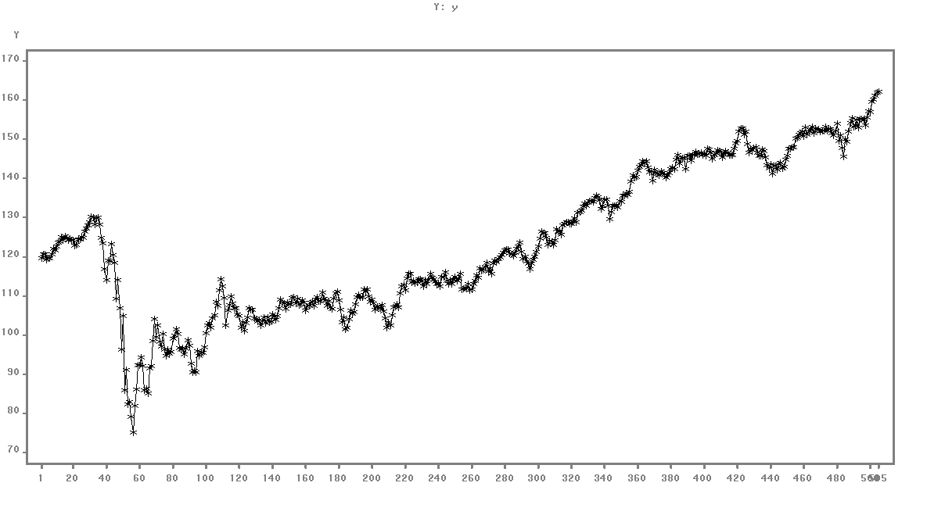
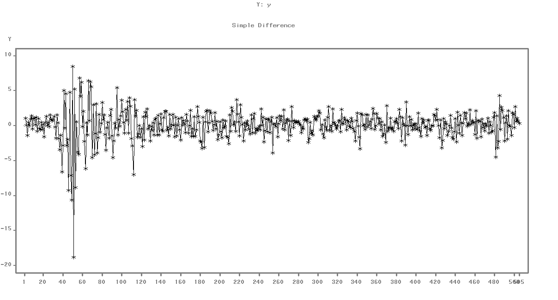
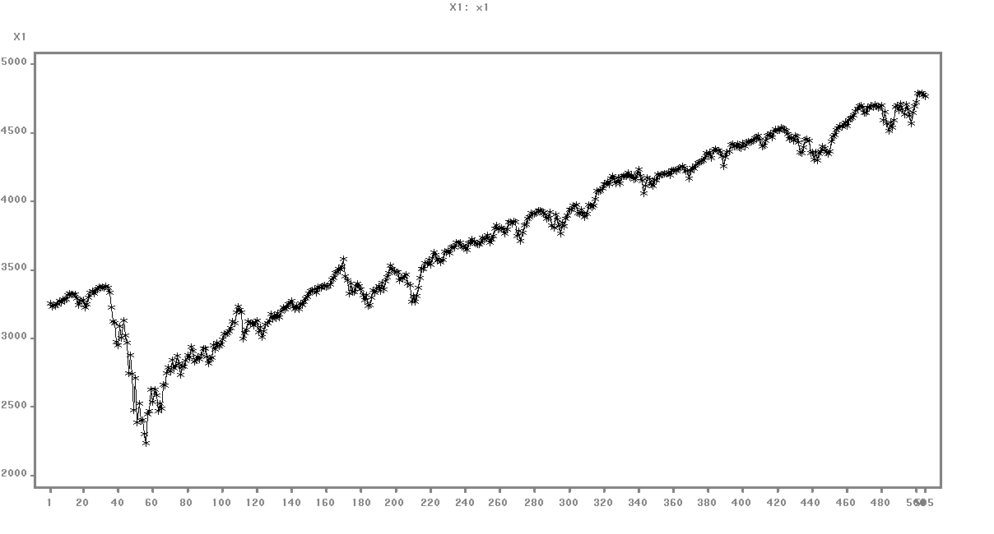
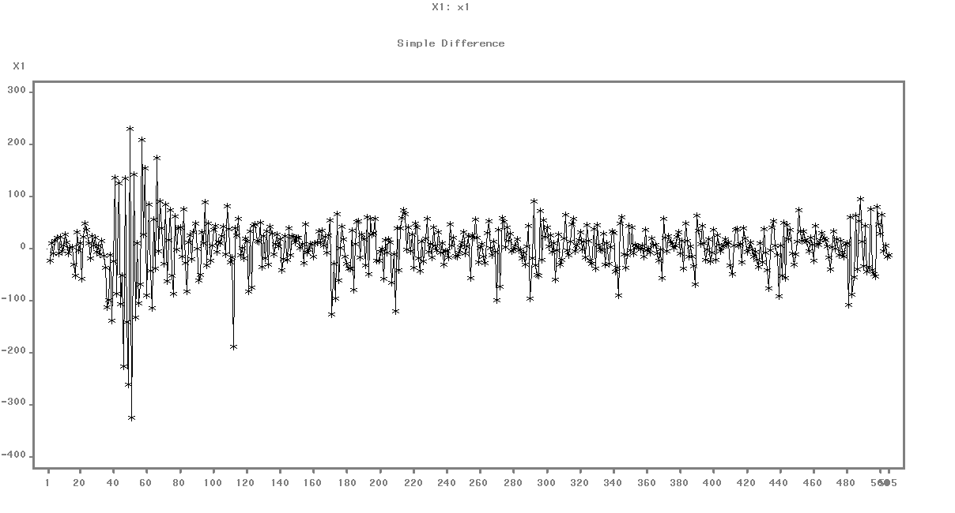
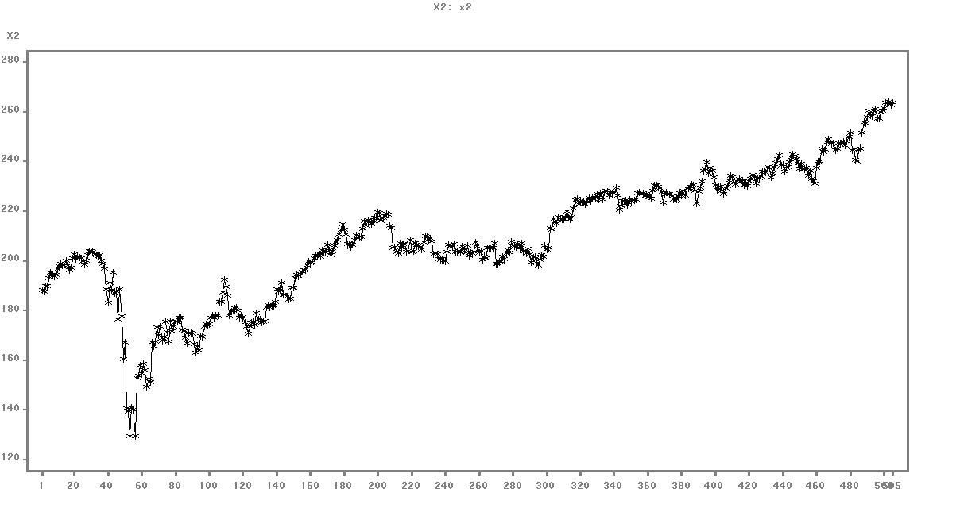
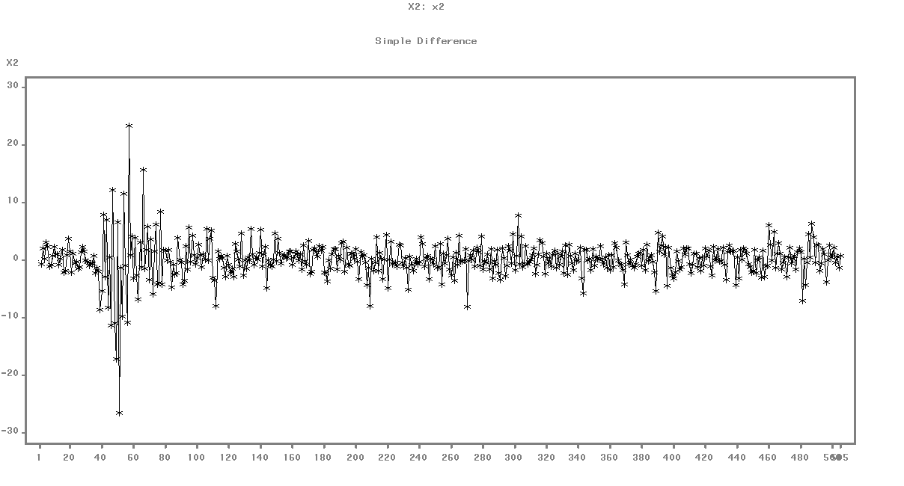
Preprocessing: Stationarity
First order differencing
y_{t}* = y_{t} - y_{t-1}
x_{1t}*
x_{2t}*

Slide 18
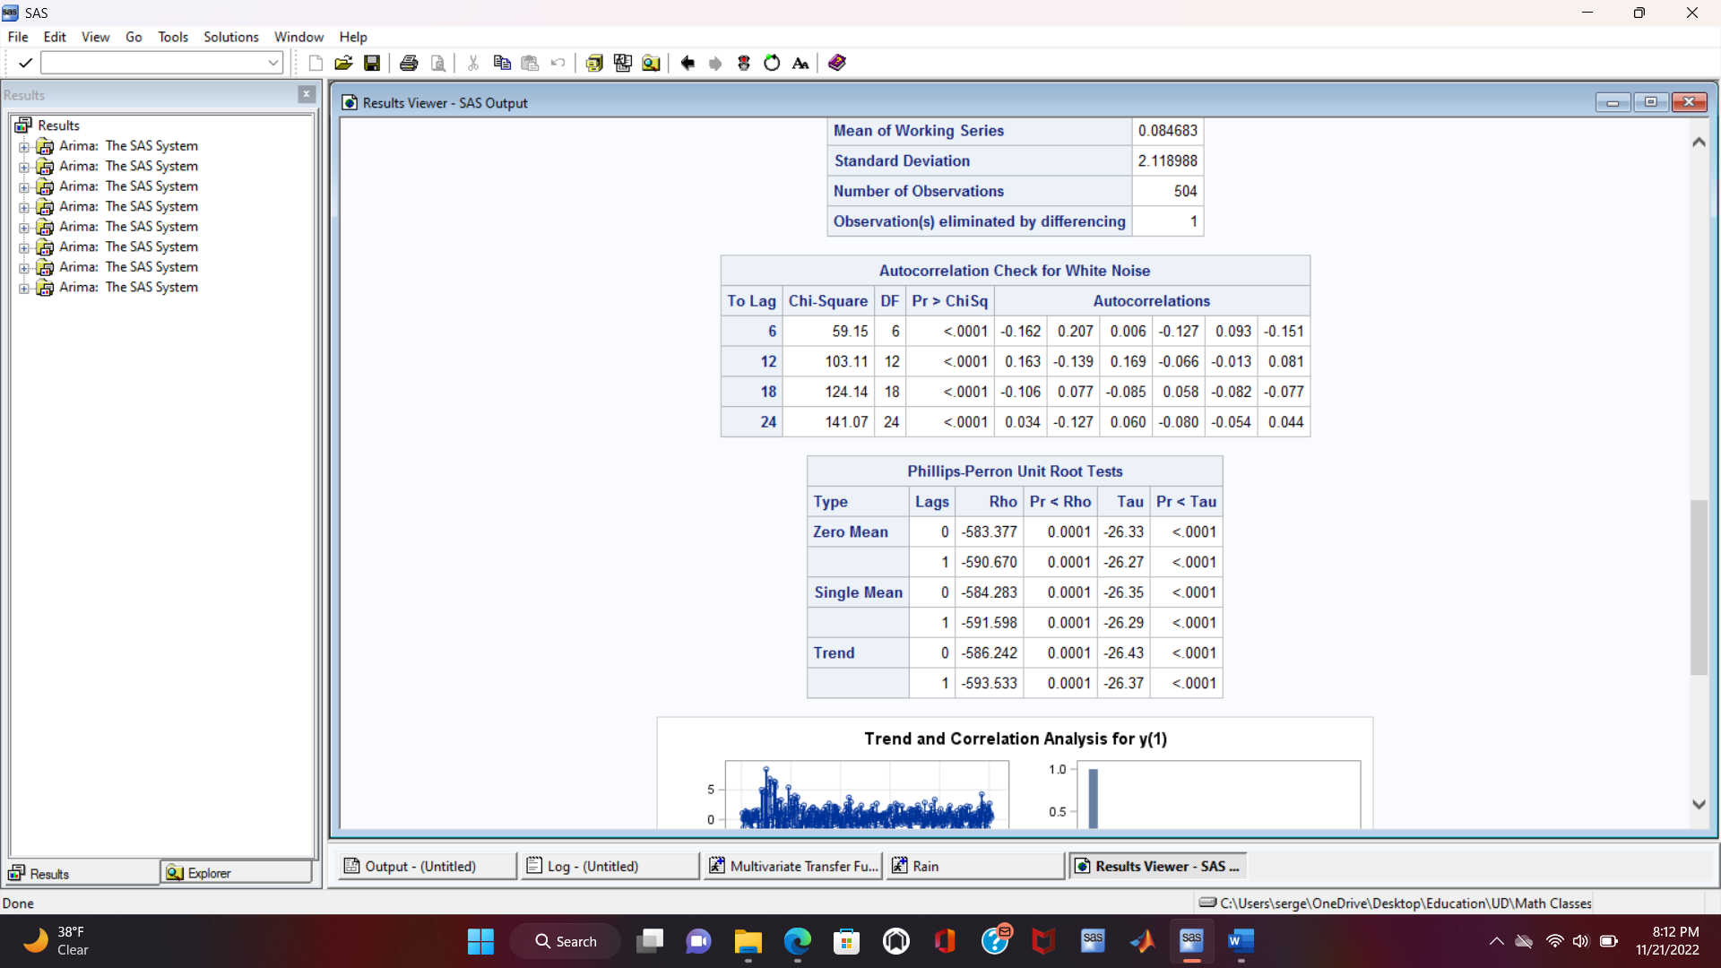
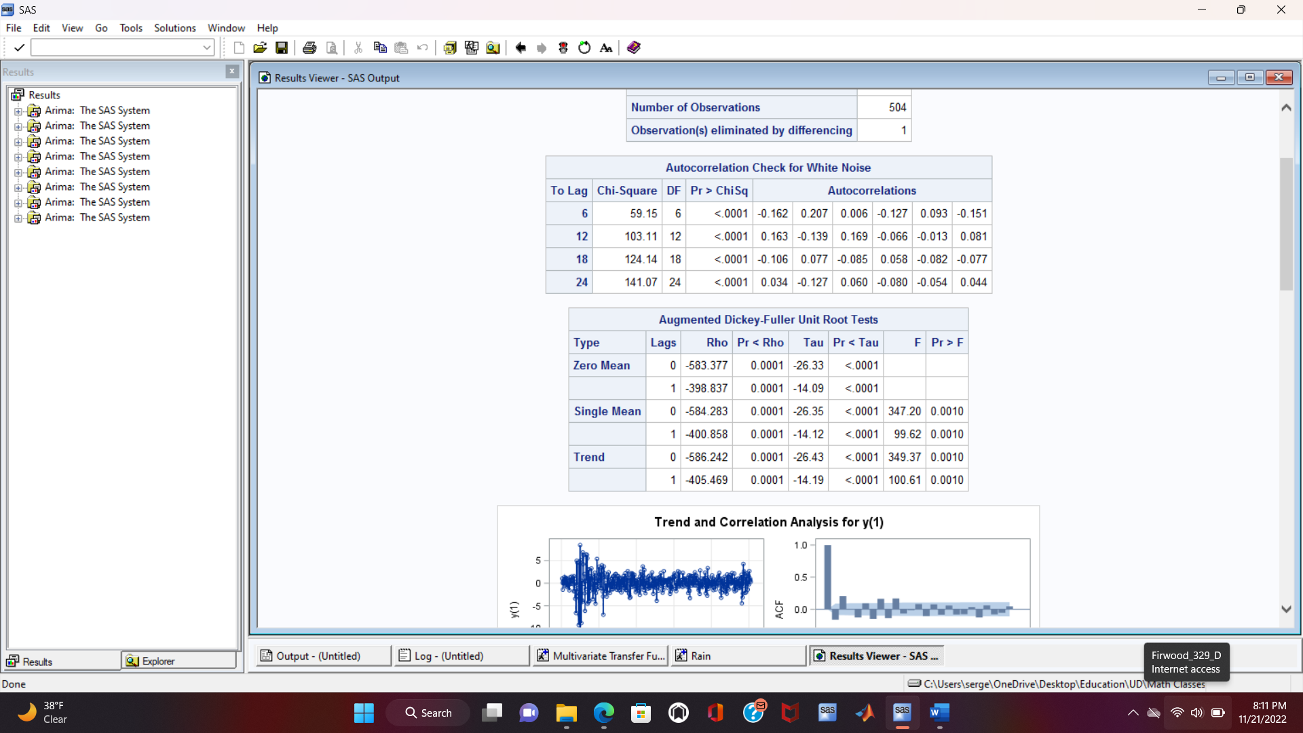
Preprocessing: Tests
The output variable: y_{t}*
The series is stationary
The series is not white noise
The same applies for both input series

Slide 19
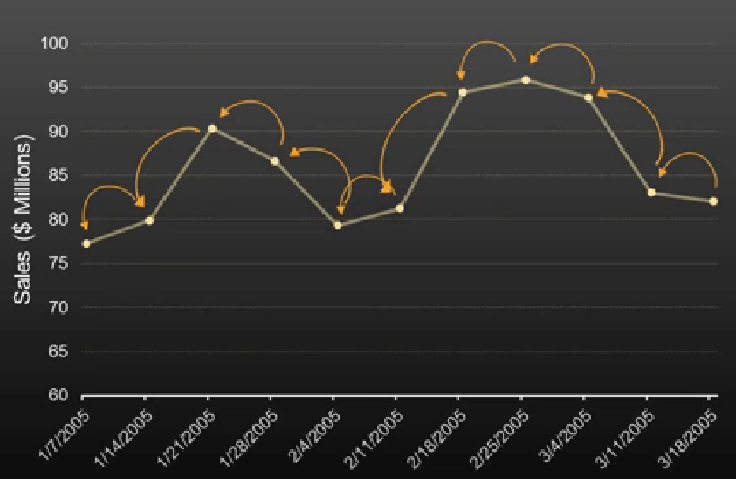
Autoregressive Models
What are AR models?
They are employed when past values of a time series can be used to model its future values.
AR(1): How much was it yesterday?
AR(p) equation
y_{t} = Φ₁y_{t-1} + Φ₂y_{t-2} + … + Φ_{p}y_{t-p} + ε_{t}
Parameters estimation
Ordinary least squares

Slide 20
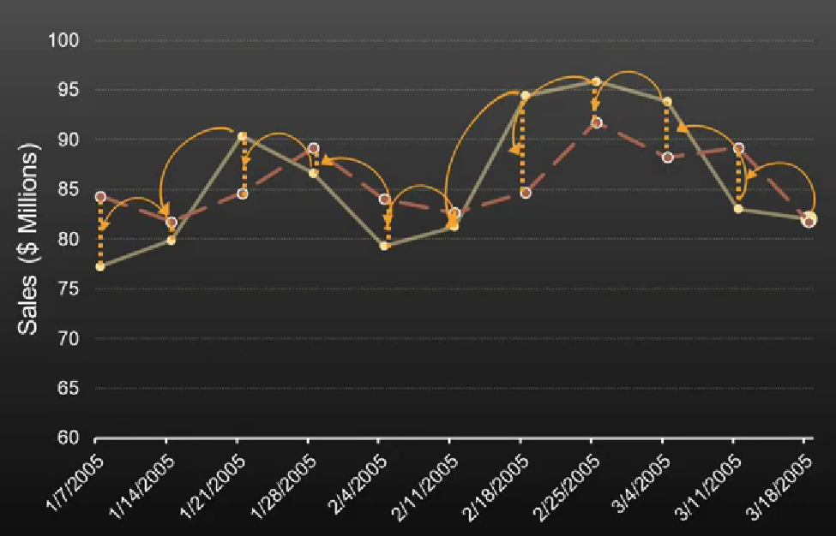
Moving Average Models
What are MA models?
MA models use the past forecast errors to predict future values.
MA(1): How wrong were you yesterday?
MA(q) equation
y_{t} = µ + θ₁ε_{t-1} + θ₂ε_{t-2} + … + θ_{q}ε_{t-q} + ε_{t}
Parameters estimation
Ordinary least squares

Slide 21
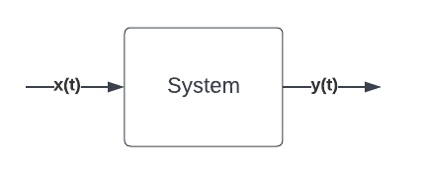
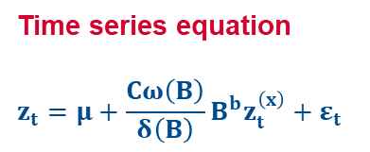
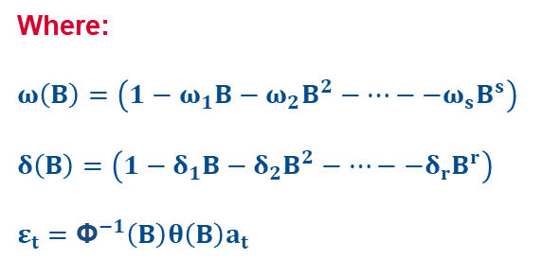
Transfer Function
What is a transfer function?
It is a mathematical function that describes the input-output relationship of a system.
Time series equation
$$z_{t}=μ+\frac{Cω\left(B\right)}{δ\left(B\right)}B^{b}z_{t}^{\left(x\right)}+ε_{t}$$
Where:
$$ω\left(B\right)=\left(1−ω_{1}B−ω_{2}B^{2}−…−−ω_{s}B^{s}\right)$$
$$δ\left(B\right)=\left(1−δ_{1}B−δ_{2}B^{2}−…−−δ_{r}B^{r}\right)$$
$$ε_{t}={\text{Φ}}^{−1}\left(B\right)θ\left(B\right)a_{t}$$

Slide 22
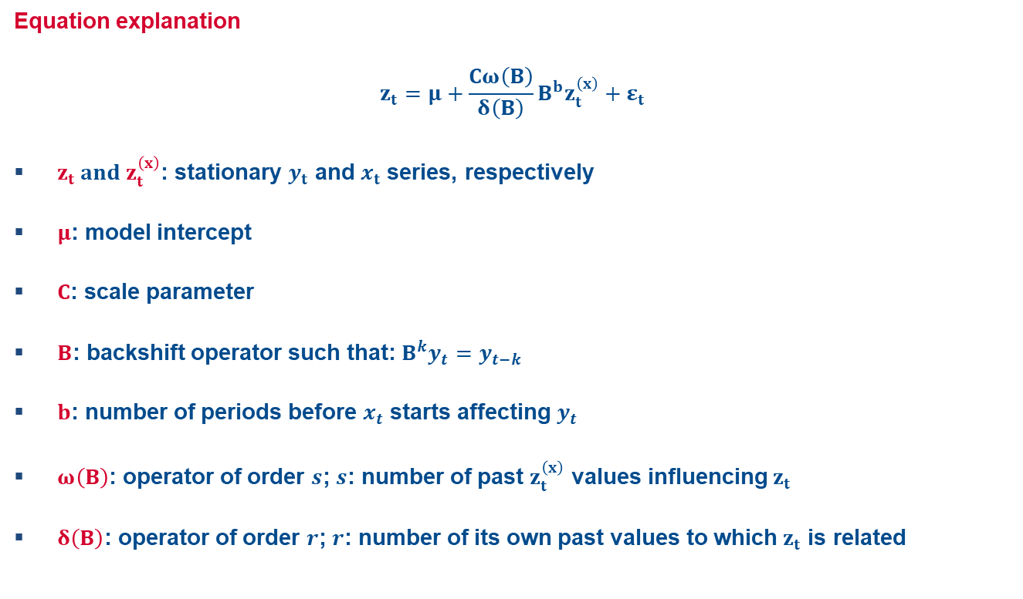
Transfer Function
Equation explanation
$$z_{t}=μ+\frac{Cω\left(B\right)}{δ\left(B\right)}B^{b}z_{t}^{\left(x\right)}+ε_{t}$$
$z_{t} and z_{t}^{\left(x\right)}$: stationary $y_{t}$ and $x_{t}$ series, respectively
$μ$: model intercept
$C$: scale parameter
$B$: backshift operator such that: $B^{k}y_{t}=y_{t−k}$
$b$: number of periods before $x_{t}$ starts affecting $y_{t}$
$ω\left(B\right)$: operator of order $s$; $s$: number of past $z_{t}^{\left(x\right)}$ values influencing $z_{t}$
$δ\left(B\right)$: operator of order $r$; $r$: number of its own past values to which $z_{t}$ is related

Slide 23
Transfer Function
Transfer function steps
Filter
Cross correlation
Preliminary transfer function
Residuals modeling

Slide 24
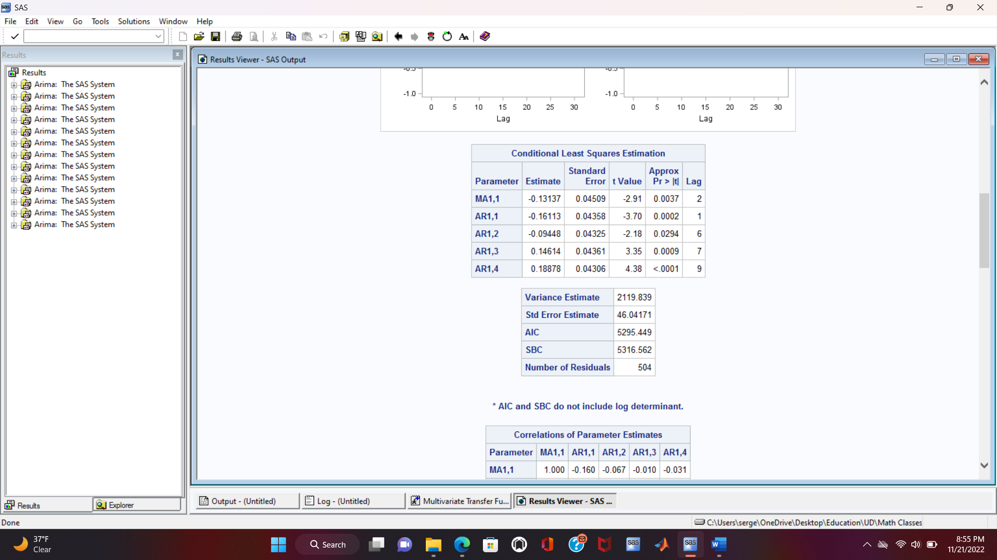
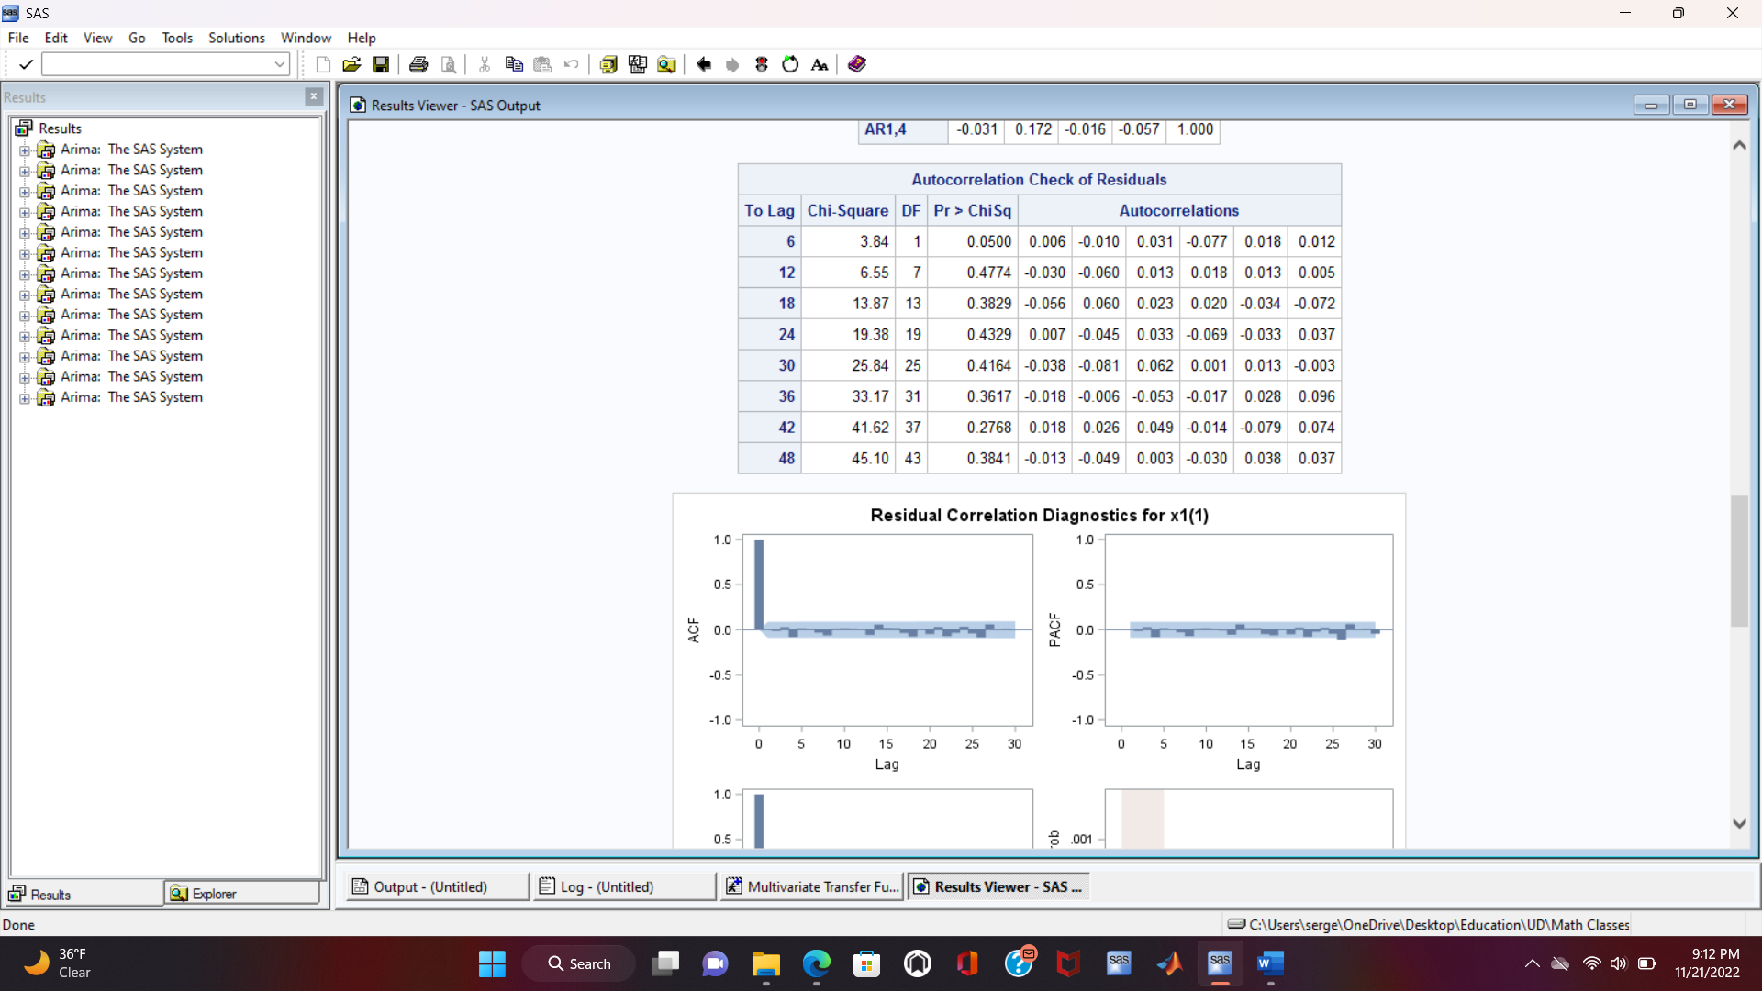
Transfer Function with the First Input
First input filter
ARIMA([1,6,7,9], 1, [2])
The parameters are significant
No autocorrelation in the residuals

Slide 25
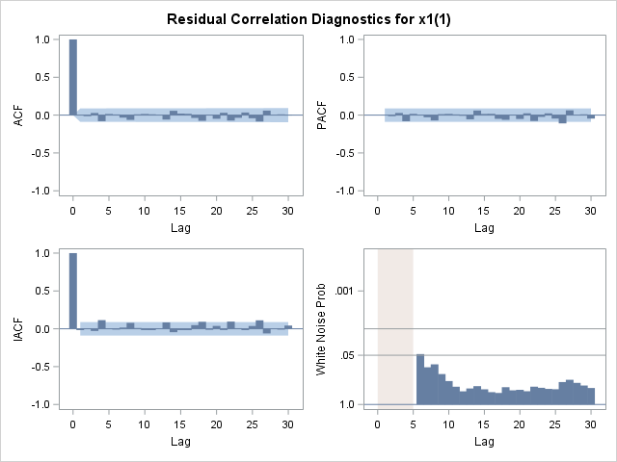
Transfer Function with the First Input
First input filter
Residuals are not autocorrelated (Once again)
Residuals are white noise

Slide 26
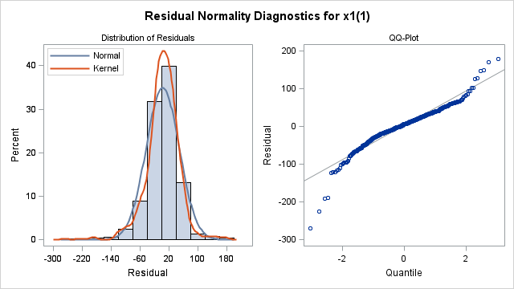
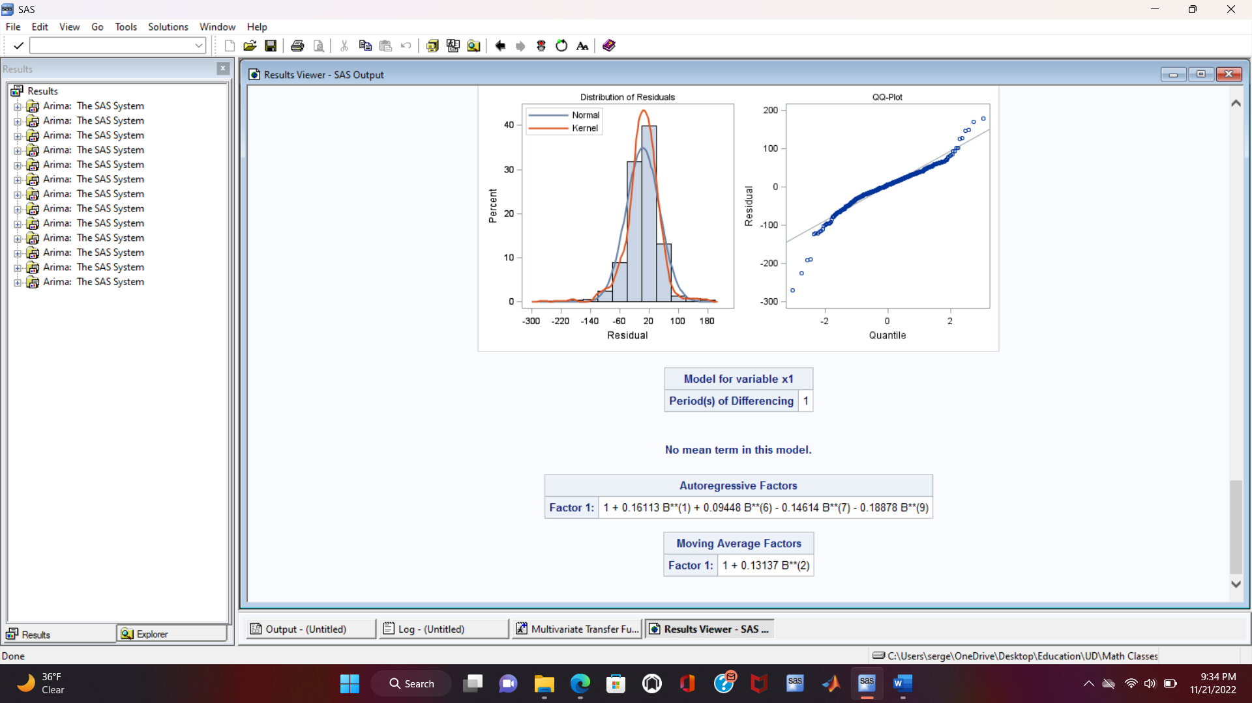
Transfer Function with the First Input
First input filter
Distribution is close to a Gaussian one
The probability of a residual having a value of zero is high
Least squares estimation of the parameters

Slide 27
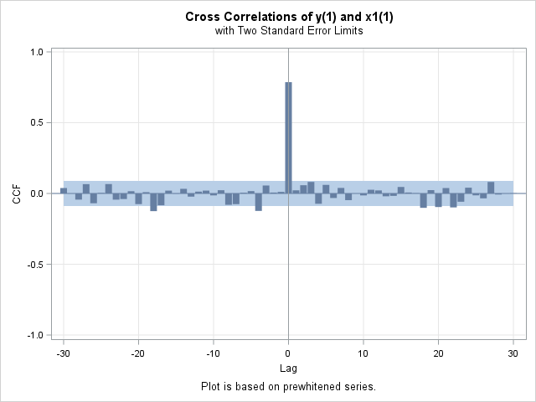
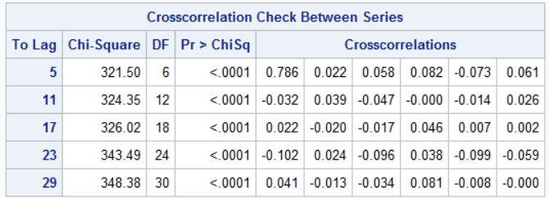
Transfer Function with the First Input
First input cross correlation

Slide 28
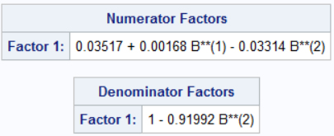
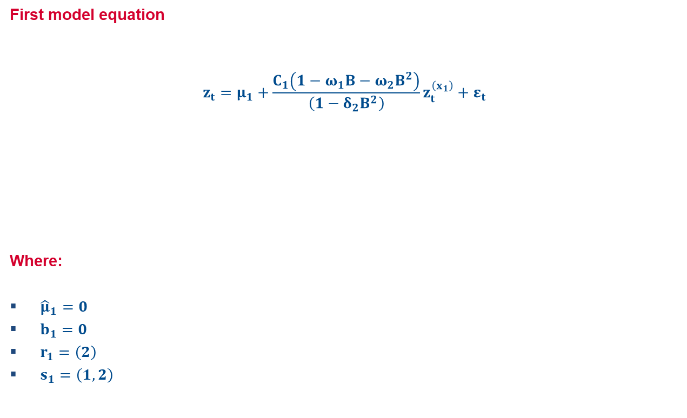
Transfer Function with the First Input
First model equation
$$z_{t}=μ_{1}+\frac{C_{1}\left(1−ω_{1}B−ω_{2}B^{2}\right)}{\left(1−δ_{2}B^{2}\right)}z_{t}^{\left(x_{1}\right)}+ε_{t}$$
Where:
${\hat{μ}}_{1}=0$
$b_{1}=0$
$r_{1}=\left(2\right)$
$s_{1}=\left(1,2\right)$

Slide 29
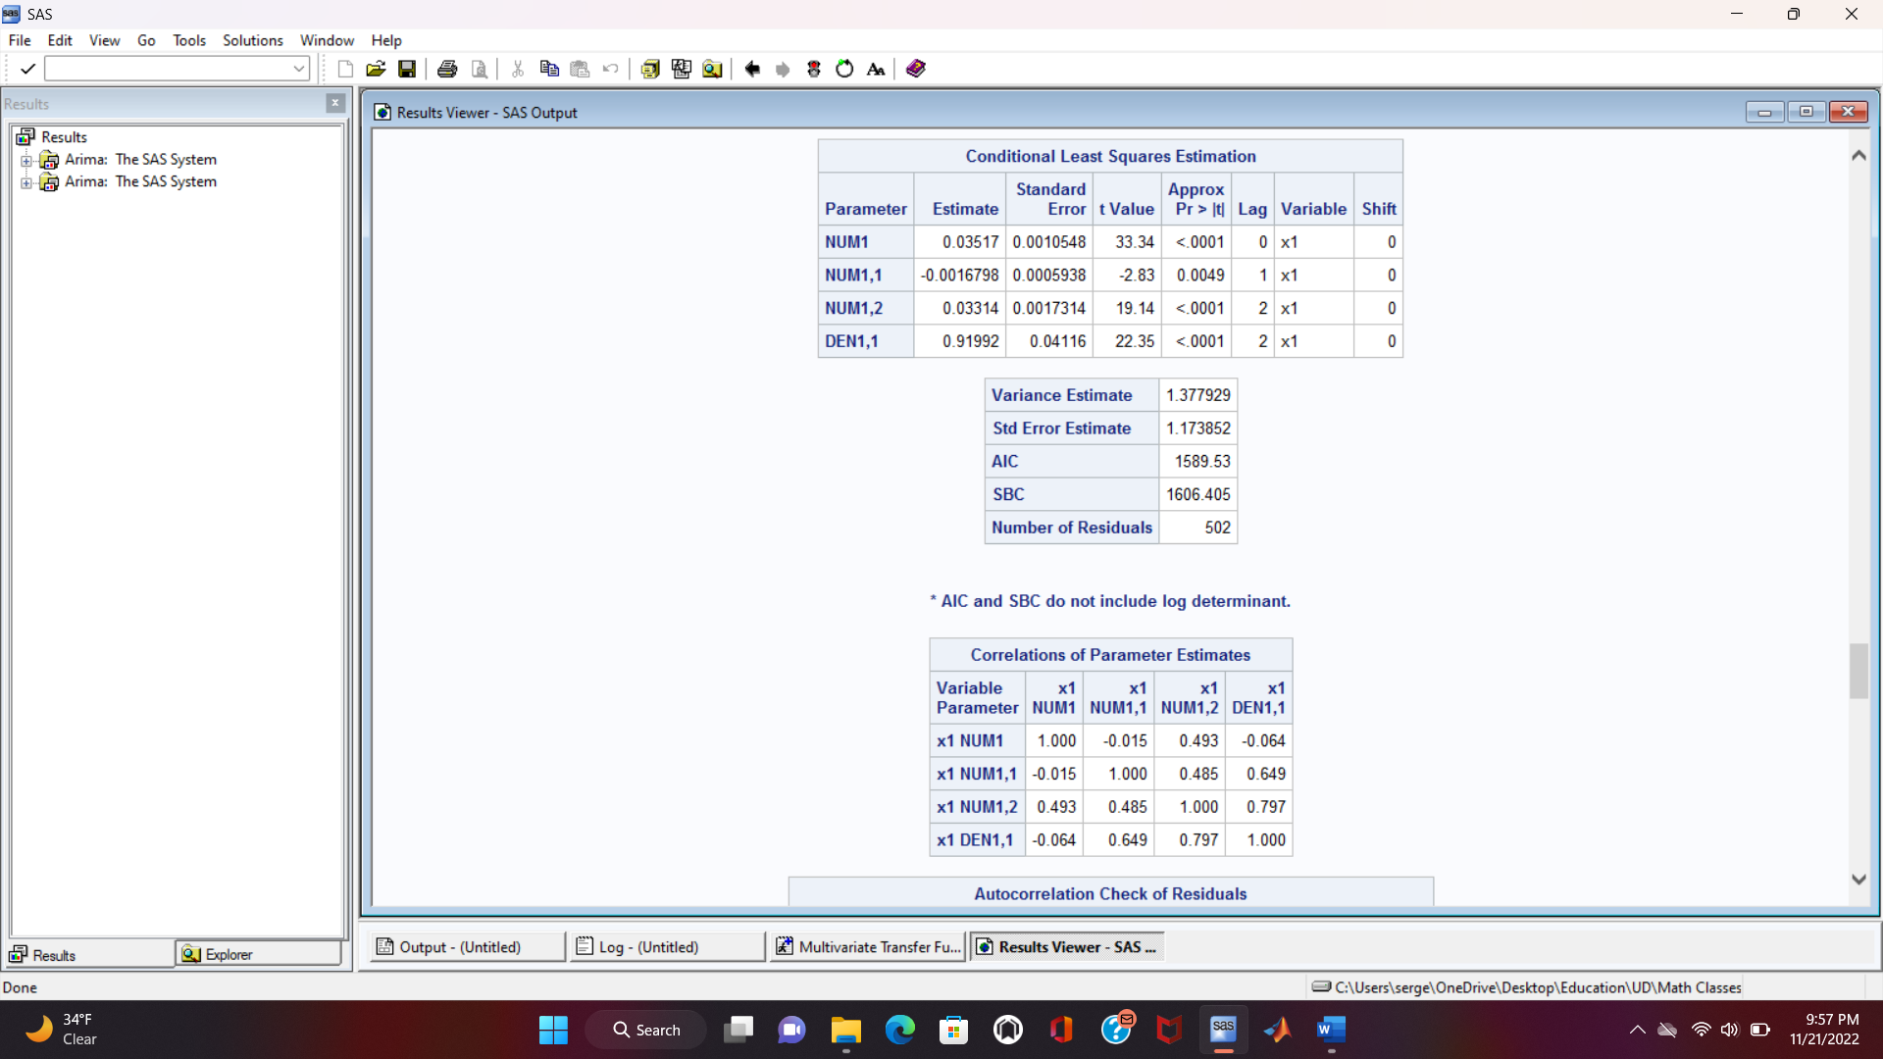
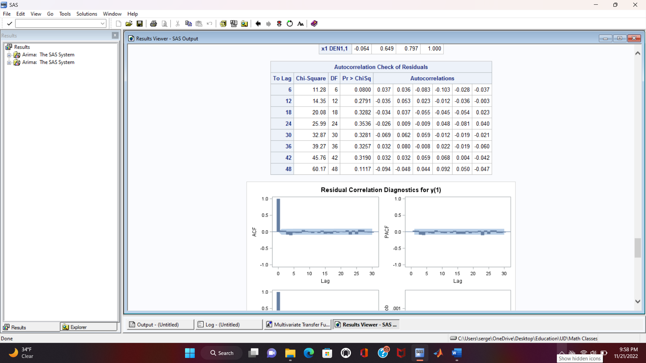
Transfer Function with the First Input
Estimates and diagnostics

Slide 30
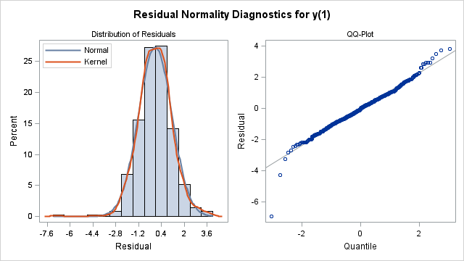
Transfer Function with the First Input
First model diagnostics

Slide 31
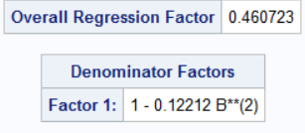
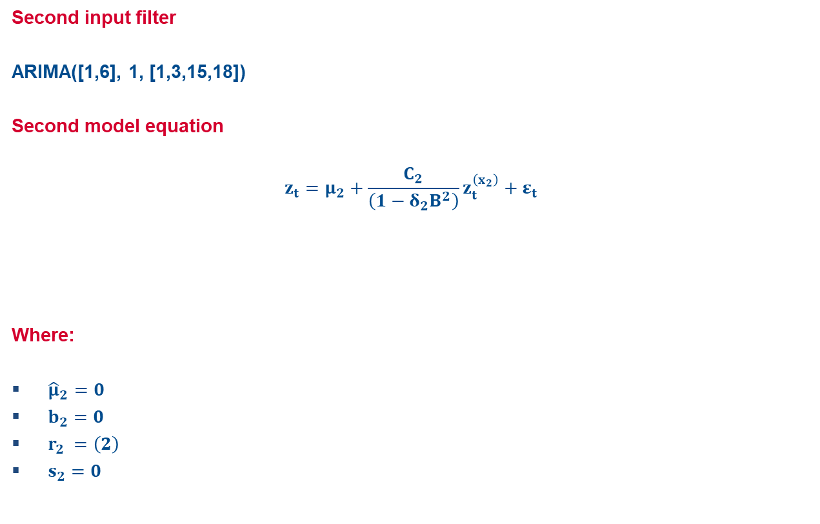
Transfer Function with the Second Input
Second input filter
ARIMA([1,6], 1, [1,3,15,18])
Second model equation
$$z_{t}=μ_{2}+\frac{C_{2}}{\left(1−δ_{2}B^{2}\right)}z_{t}^{\left(x_{2}\right)}+ε_{t}$$
Where:
${\hat{μ}}_{2}=0$
$b_{2}=0$
$r_{2} =\left(2\right)$
$s_{2}=0$

Slide 32
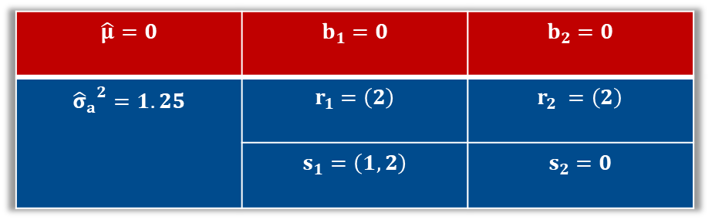
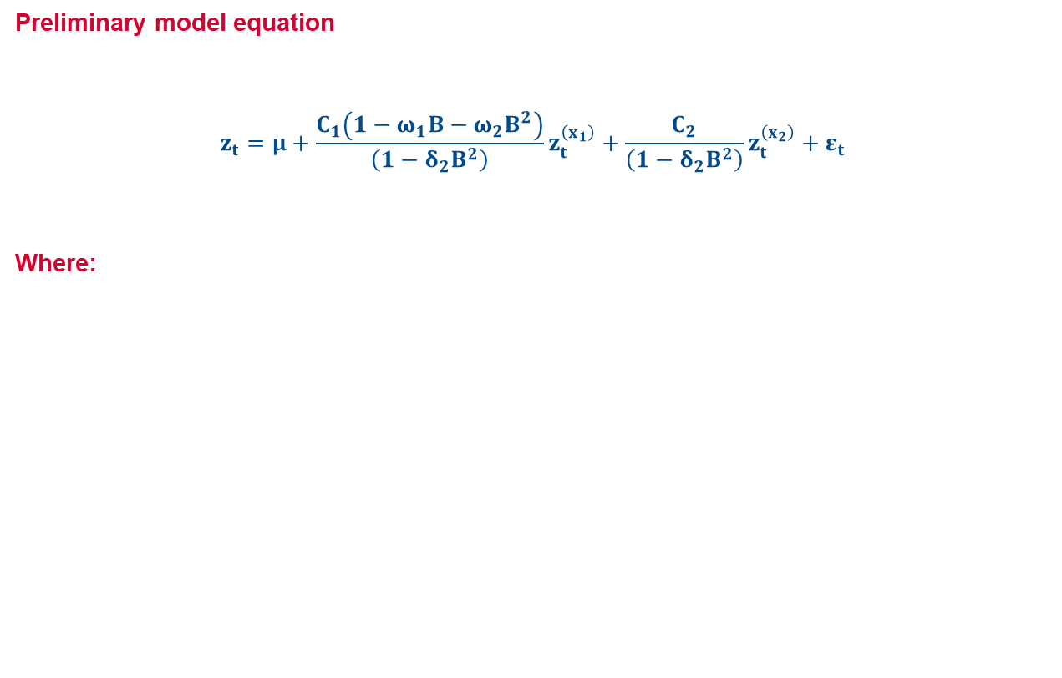
Diagnostics and Preliminary model
Preliminary model equation
$$z_{t}=μ+\frac{C_{1}\left(1−ω_{1}B−ω_{2}B^{2}\right)}{\left(1−δ_{2}B^{2}\right)}z_{t}^{\left(x_{1}\right)}+\frac{C_{2}}{\left(1−δ_{2}B^{2}\right)}z_{t}^{\left(x_{2}\right)}+ε_{t}$$
Where:
$$\hat{μ}=0$$ | $$b_{1}=0$$ | $$b_{2}=0$$
$${{\hat{σ}}_{a}}^{2}=1.25$$ | $$r_{1}=\left(2\right)$$ | $$r_{2} =\left(2\right)$$
 | $$s_{1}=\left(1,2\right)$$ | $$s_{2}=0$$

Slide 33
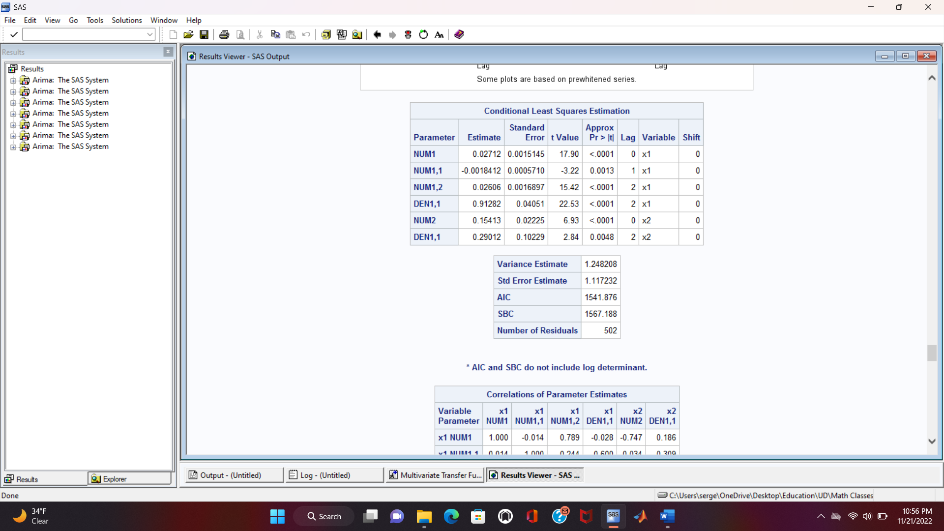
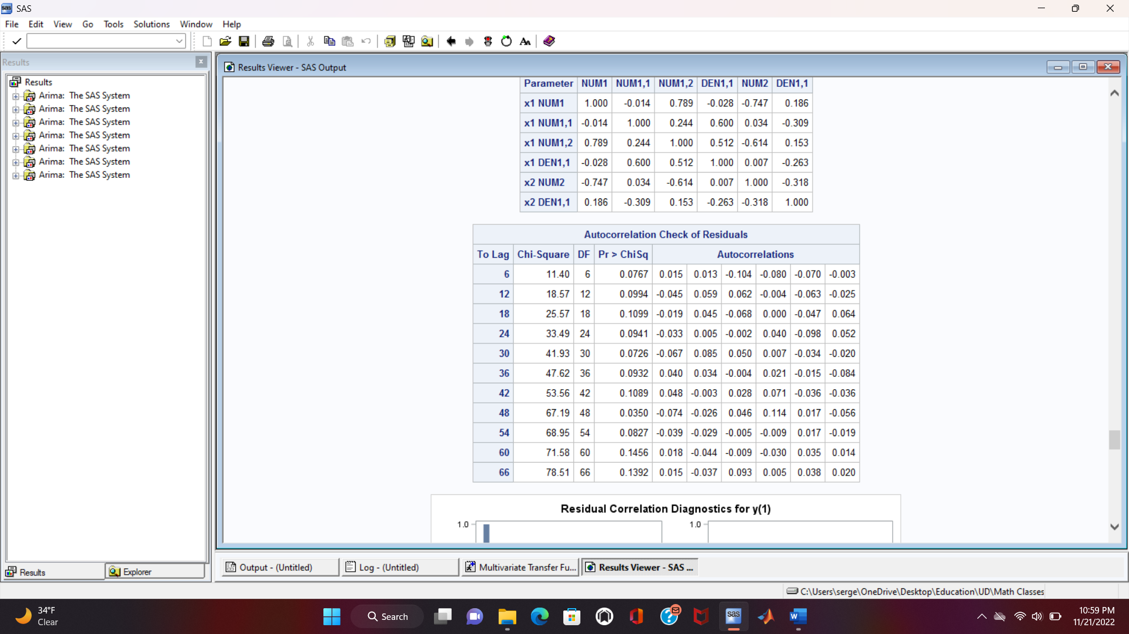
Diagnostics and Preliminary model
Estimates and diagnostics

Slide 34
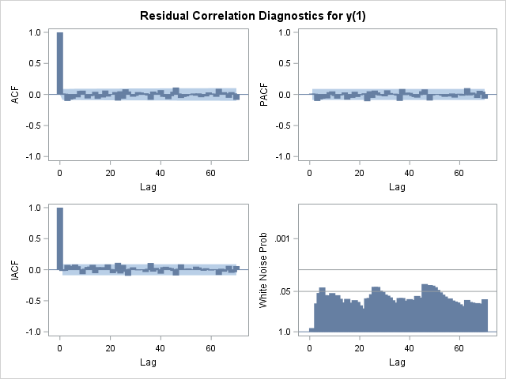
Diagnostics and Preliminary model
A better model is yet to be constructed

Slide 35
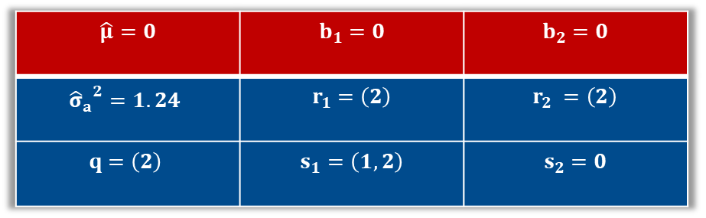
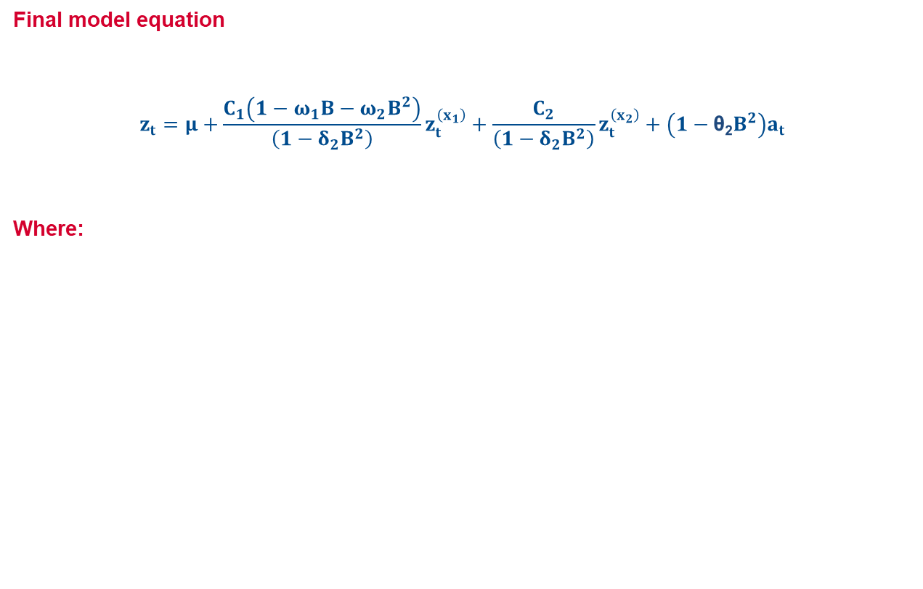
Diagnostics and Final model
Final model equation
$$z_{t}=μ+\frac{C_{1}\left(1−ω_{1}B−ω_{2}B^{2}\right)}{\left(1−δ_{2}B^{2}\right)}z_{t}^{\left(x_{1}\right)}+\frac{C_{2}}{\left(1−δ_{2}B^{2}\right)}z_{t}^{\left(x_{2}\right)}+\left(1−\text{θ}\text{2}B^{2}\right)a_{t}$$
Where:
$$\hat{μ}=0$$ | $$b_{1}=0$$ | $$b_{2}=0$$
$${{\hat{σ}}_{a}}^{2}=1.24$$ | $$r_{1}=\left(2\right)$$ | $$r_{2} =\left(2\right)$$
$$q=\left(2\right)$$ | $$s_{1}=\left(1,2\right)$$ | $$s_{2}=0$$

Slide 36
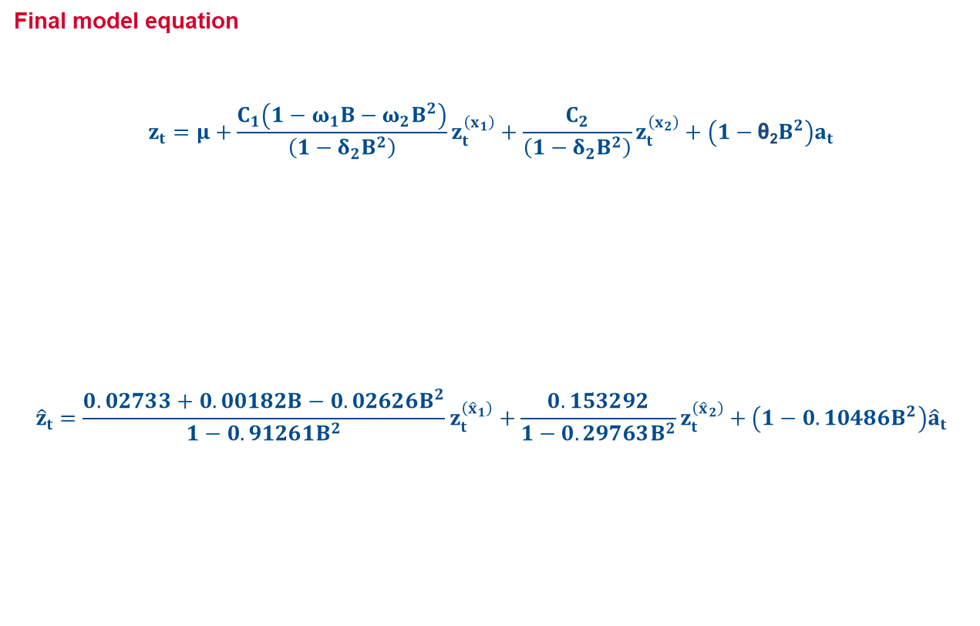
Diagnostics and Final model
Final model equation
$$z_{t}=μ+\frac{C_{1}\left(1−ω_{1}B−ω_{2}B^{2}\right)}{\left(1−δ_{2}B^{2}\right)}z_{t}^{\left(x_{1}\right)}+\frac{C_{2}}{\left(1−δ_{2}B^{2}\right)}z_{t}^{\left(x_{2}\right)}+\left(1−\text{θ}\text{2}B^{2}\right)a_{t}$$
$${\hat{z}}_{t}=\frac{0.02733+0.00182B−0.02626B^{2}}{1−0.91261B^{2}}z_{t}^{\left({\hat{x}}_{1}\right)}+\frac{0.153292}{1−0.29763B^{2}}z_{t}^{\left({\hat{x}}_{2}\right)}+\left(1−0.10486B^{2}\right){\hat{a}}_{t}$$

Slide 37
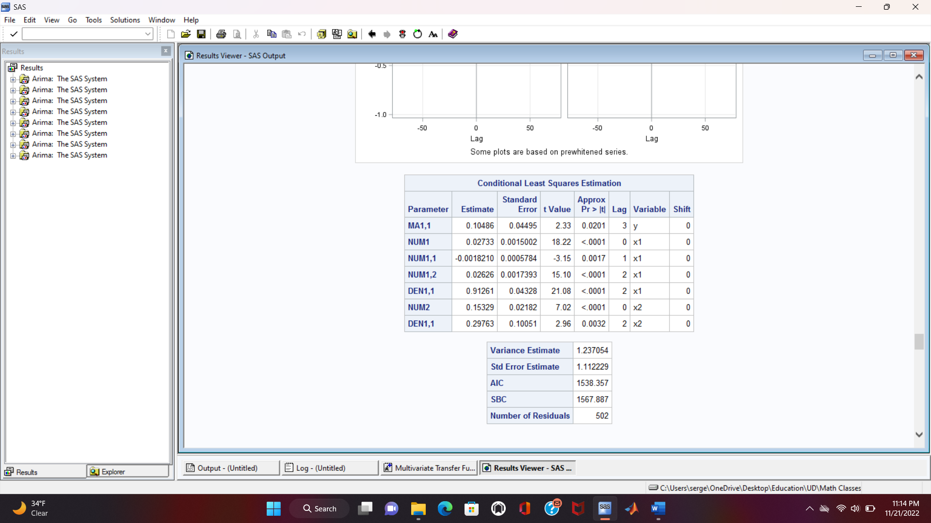
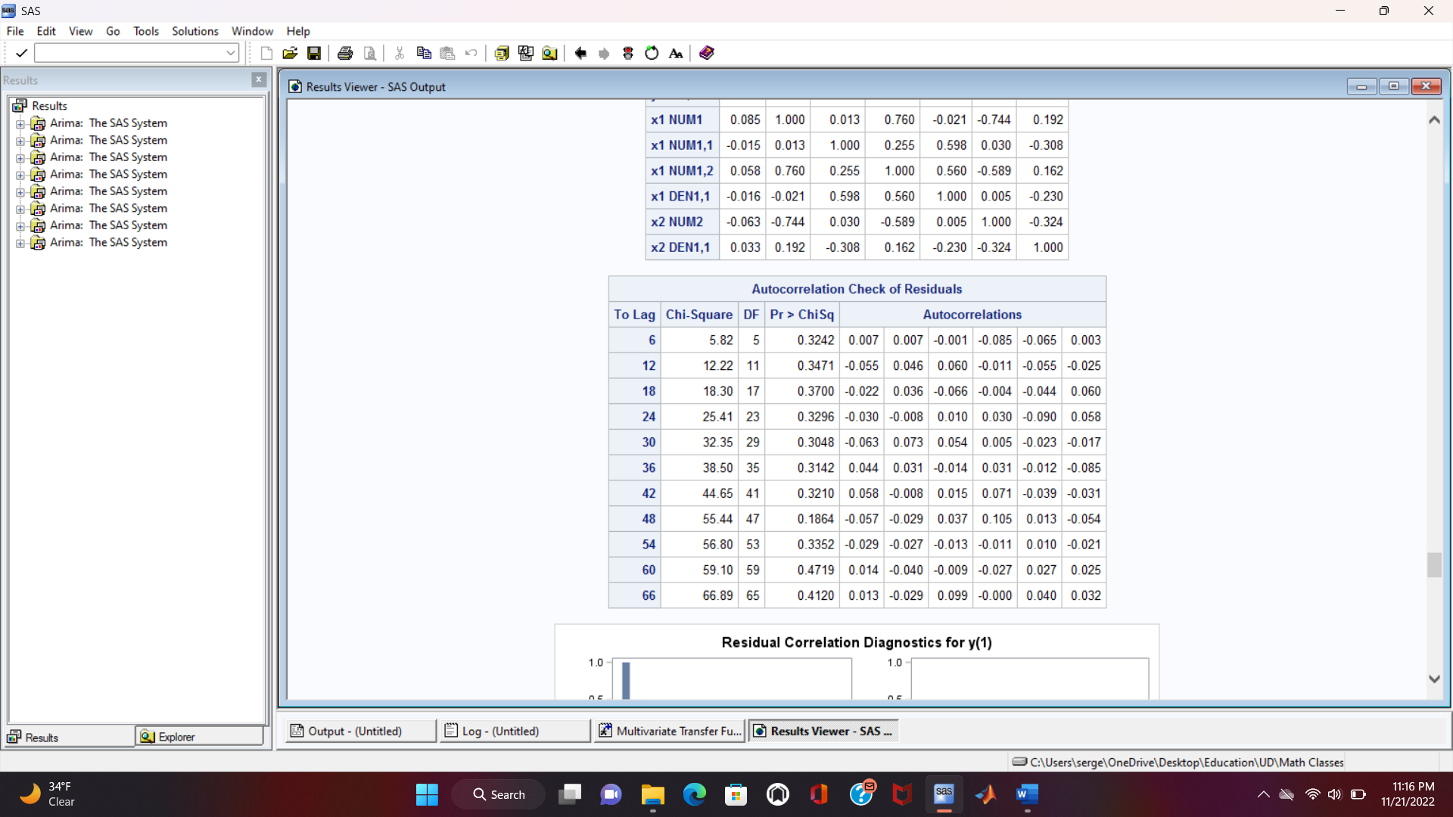
Diagnostics and Final model
Estimates and diagnostics

Slide 38
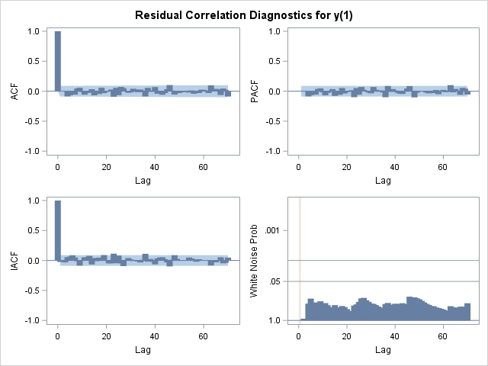
Diagnostics and Final model
The model is adequate

Slide 39
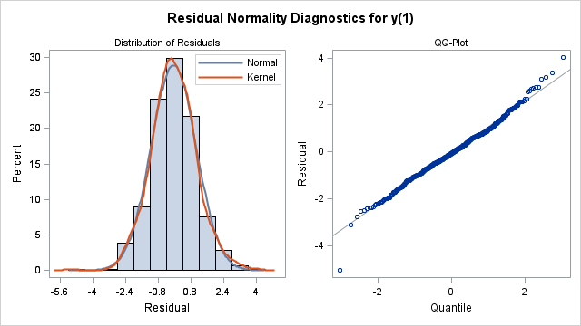
Diagnostics and Final model
The model is adequate

Slide 40
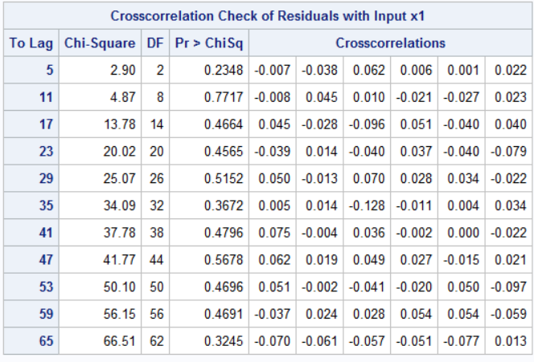
Diagnostics and Final model
First input best explains the output

Slide 41

Diagnostics and Final model
Second input best explains the output

Slide 42
Forecasting Results

Slide 43
Conclusion
The model's parameters are significant, indicating its fitness.
The passing of adequacy tests indicates that the model is adequate.
The small error between actual and forecasted values demonstrates the accuracy of the model.
Additional metrics such as AIC and SBC can be analyzed as well.
Outlier and intervention detection tests can be employed to identify and model any outliers and interventions.
Neural networks can be enhanced by incorporating time series correlation.
Questions/Comments?

Slide 44
References
Books:
George E. P. Box - Time Series Analysis Forecasting and Control (2015) 5th
Douglas C. Montgomery - Design and analysis of experiments (2017) 10th
Data:
Yahoo Finance
Software:
SAS: The code is in my GitHub account
Excel
Lucid Charts

Slide 45
THANK YOU!

